Slide 1
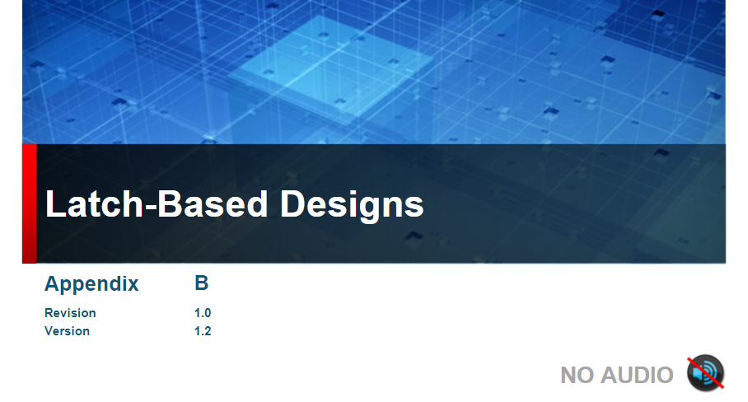

Slide 2
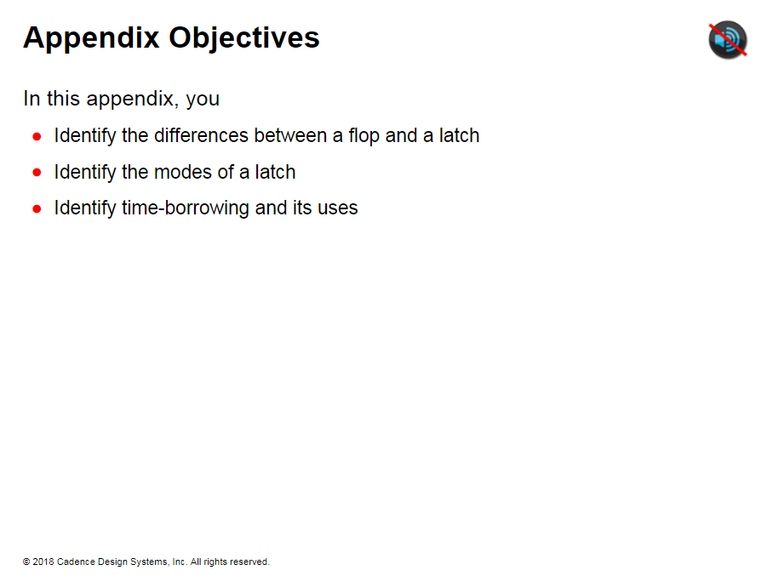

Slide 3
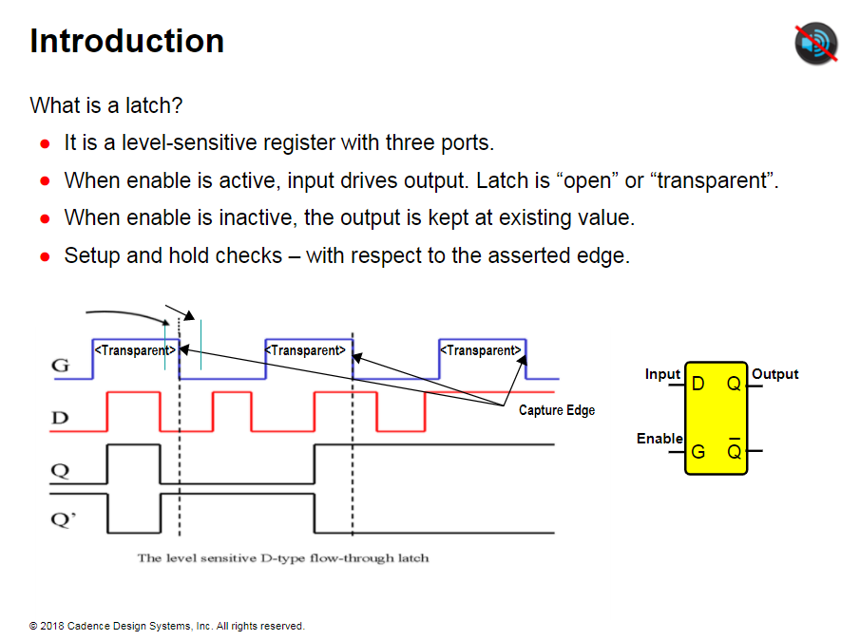
Notes:
A latch is a level-sensitive memory cell that is transparent to signals passing from the D input to the Q output when enabled and holds the value of D on Q at the time it becomes disabled. During the time period where the latch allows input to pass through, it is said to be in a transparent (active) state.
This means data flow through a latch depends on the state of it is enable input In opaque (disabled) state data flow is inhibited. output is latched and cannot change.
Flip-Flop is an edge-triggered device that samples (captures) and stores the value present at its data input when the clock input makes an enabling transition. Flip-Flop is a full-cycle memory device which means the value is stored for a full cycle. Latch is a half-cycle device which means the value is stored for half a cycle only.
A latch requires additional timing check compared to a flip-flop. Setup and hold timing checks on the data input of the latch are with respect to the enable signal-transition from asserted to nonasserted.

Slide 4
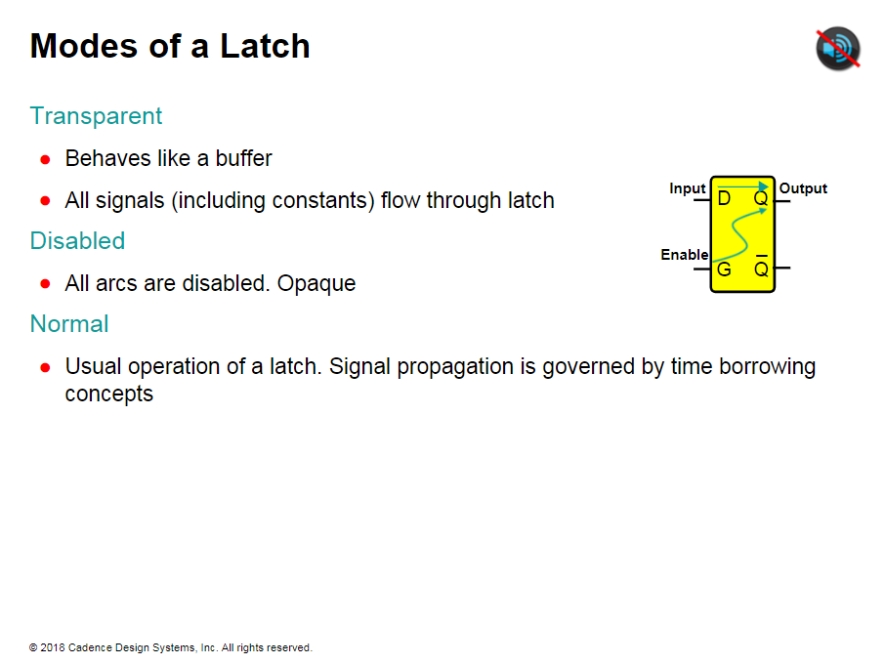
Notes:
This enhancement allows the latch to be in one of three modes.
Transparent: All signals (including constants) flow through the latch D → Q arc. In this mode, the latch essentially behaves like a buffer.
Disabled: Both clock → Q and D → Q arcs are disabled. No data or clock signal propagate through the latch. This is a special case of arc blocking. Latch can also be disabled by setting a disable constant on a latch enable.
Normal: This is the usual operation mode of the latch. Signal propagation at the output and input pins is governed by time borrowing concepts.

Slide 5
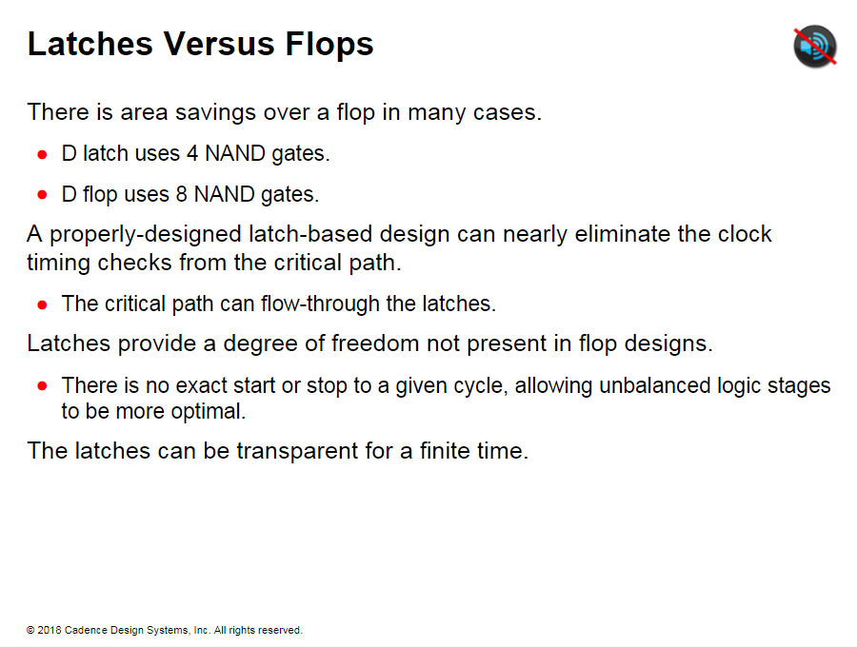
Notes:
If data arrives at setup timebefore the trailing edge of the enable, the data will be latched, and circuit timing will be valid.
This allows an extra half cycle within which data can arrive before being late.
You can use this half-cycle to increase the clock frequency of a circuit by compensating for different path delays between latches.
Latches are transparent for a finite time during which the D input may stabilize and the logic following the Q output could begin evaluation. Flip-Flop is a full cycle memory device.

Slide 6
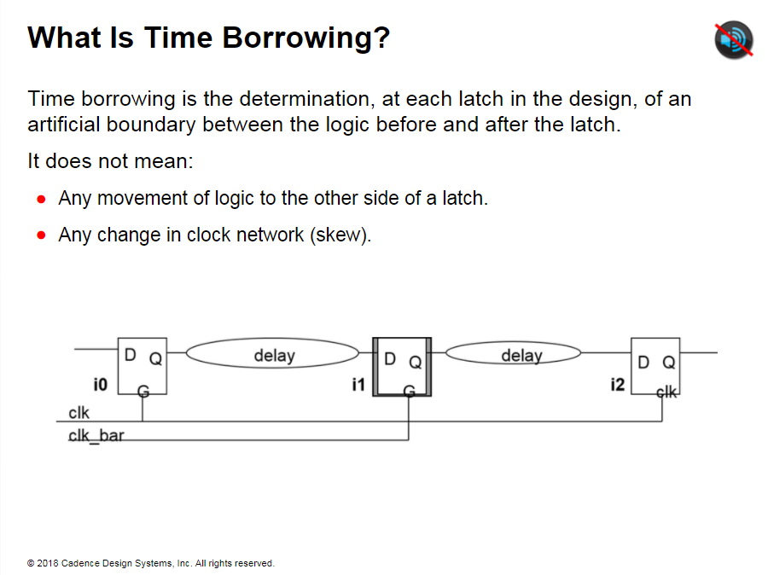
Notes:
Allowing data to change while the latch is transparent is known as borrowing.
In a physical circuit, optimal time borrowing automatically occurs. The logic following the Q output is always updated with the latest value passing from D through the latch, so that when D is stable. The computation for logic following the Q output begins immediately. Time borrowing is an attempt to model this behavior.

Slide 7
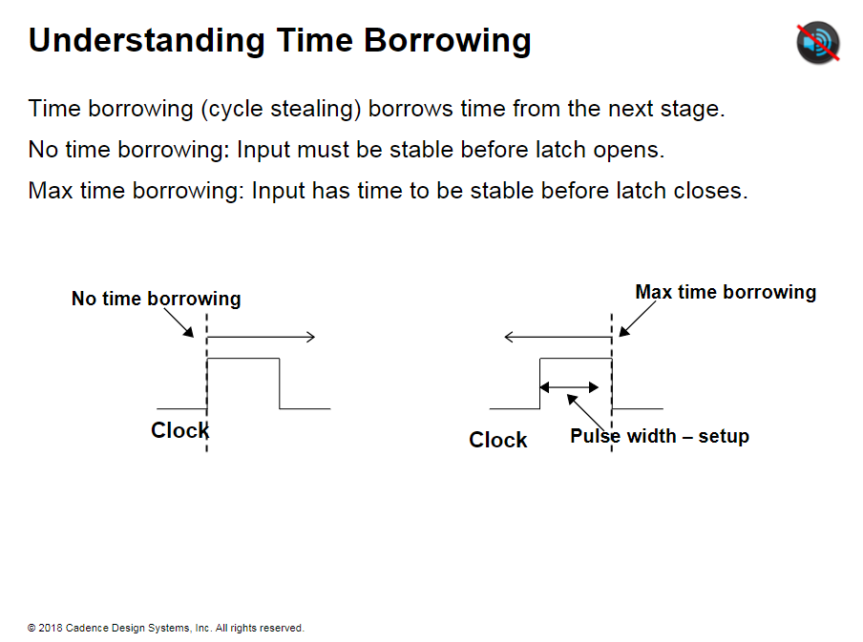

Slide 8
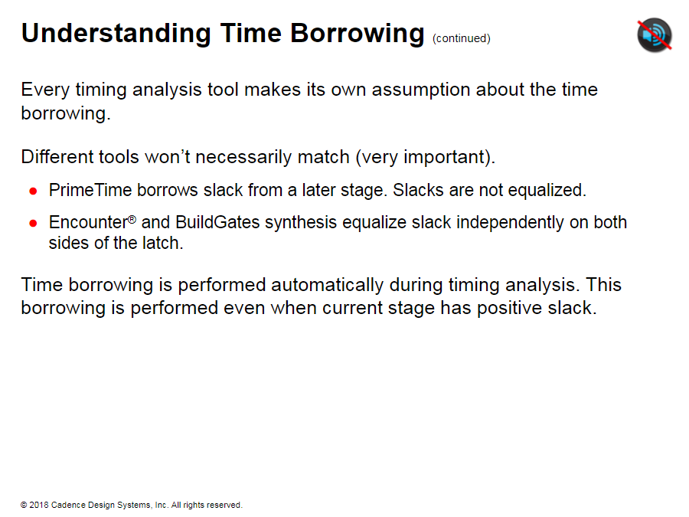
Notes:
Build Gates optimization uses a budgeted or slack-stealing approach to ensure optimization convergence. Encounter RTL Compiler also uses the slack-stealing approach.
Slack is balanced across all transparent latches.
In budgeted mode, paths will not be reported through latches.

Slide 9
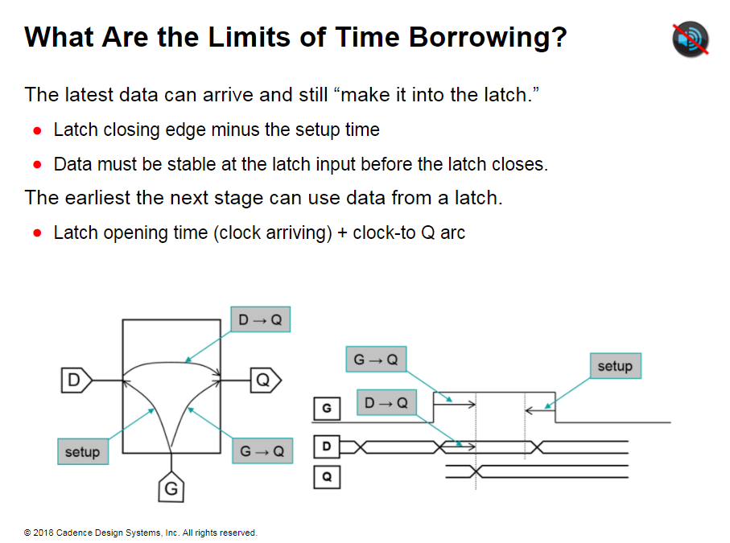

Slide 10
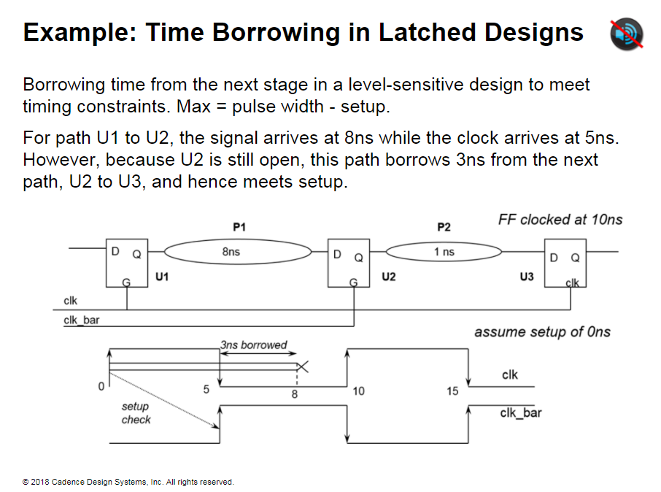
Notes:
Example: Time Borrowing in Latched Designs U1, U2 and U2 are level- sensitive latches (active when Clk= 1).
P1 and P2 (logic clouds) are combinational logic paths. Assumptions
* Library setup time = 0
* Path lengths: Pl = 8ns. P2 = Ins
Violation at U2
* The signal arrives at 8ns and the clock arrives at 5ns.
With time borrowing:
* U2 is “transparent” for 5ns.
* 3ns can be “borrowed” from U2 → U3 path (to meet setup time at U2).
* Path Pl can “borrow” this time and meet timing. * Data is required to arrive at U3 before 10ns.
‘
Data arrives at 8 +1 = 9 ns: data is valid to be latched through U3.

Slide 11
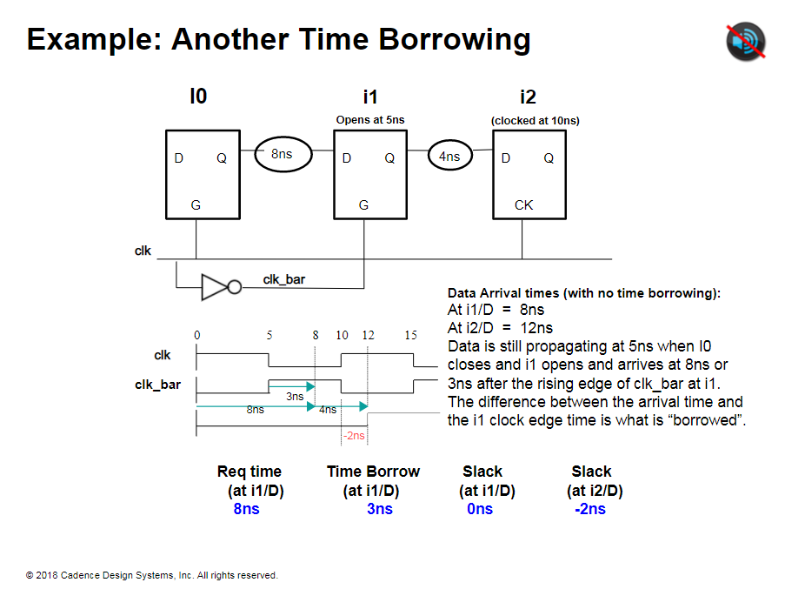
Notes:
Explanation of the values of the table at the bottom.
The overall time of the data to be propagated is limited by latch 12 which will be clocked at 10ns.
For path i0 to i1, the signal arrives at 8ns while the clock arrives at S5ns.
However, since i1 is still open, this path borrows 3ns from the next path (i1 to i2), and thereby violates timing by 2ns at i2.

Slide 12
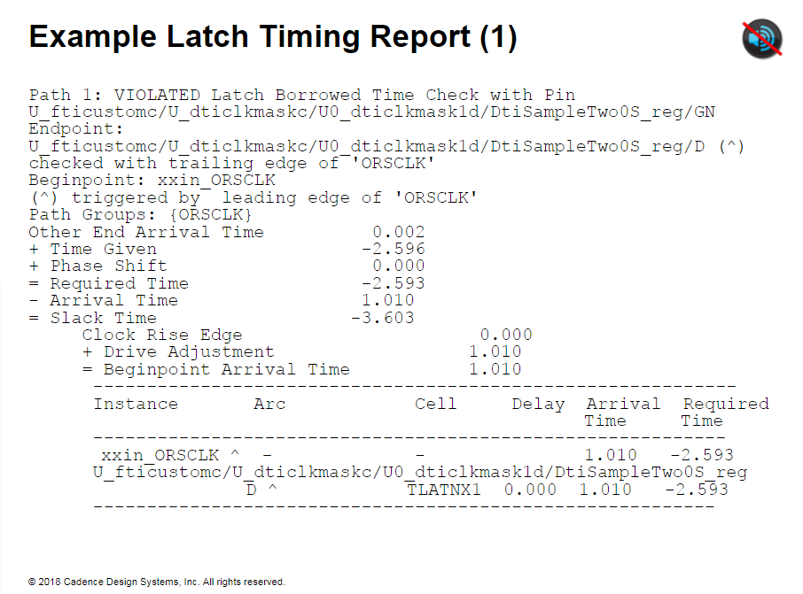

Slide 13
